Slide 1
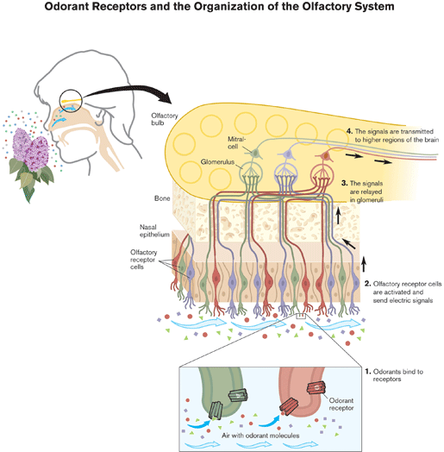
The Sense of Smell

Slide 2
Olfactory Mucous Membrane
-Olfactory receptor cells
-Area of 5cm² in roof of nasal cavity near the septum
-10 to 20 million receptor cells
-Each olfactory receptor is a neuron
-Olfactory mucous membrane is the place in body where NS is closest to external world
(video)

Slide 3
Composition of Olfactory epithelium
-Each neuron has a thick dendrite with an expanded end called olfactory rod
-From rods cilia project to the mucous surface
-Each receptor neuron has 10-20 cilia
-Axons of olfactory receptor neurons pierce cribriform plate of ethmoid bone and enter olfactory bulbs
-Olfactory neurons have half-time of few weeks.

Slide 4
Mucus producing Glands
-Olfactory mucous membrane is constantly covered by mucus
-Mucus is produced by Bowman’s glands, placed just under the basal lamina of the menbrane

Slide 5
Olfactory Bulbs
-Axons of receptors contact the primary dendrites of mitral cells and tufted cells.
-Forming complex globular synapses called olfactory glomeruli.
-Periglomerular cells are inhibitory neurons connecting one glomerulus to another
(video)

Slide 6
Olfactory Bulbs
-Granule cells have no axons and make reciprocal synapses with lateral dendrites of tufted and mitral cells
-Mitral and Tufted – excite granule releasing glutamate and granule cell in turn inhibits both by releasing GABA

Slide 7
Stimulation of Olfactory cells

Slide 8
Stimulation of Olfactory cells
G-protein is stimulated -triggers activation of Adenyl cyclase (enzyme speeds up the conversion of ATP to cAMP – cAMP then binds to action channels in membrane of cilia- this causes channels to open and Ca ions to enter cilia – influx of Ca ions activates Cl channels to open and Cl leaves. Membrane becomes depolarized and AP is created. The action potential travels down the axon of olfactory receptor cell eventually meets with the other axons and forms the olfactory nerve (CN I)

Slide 9
Stimulation of olfactory cells

Slide 10
Transmission of smell signals to CNS

Slide 11
Olfactory thresholds and discrimination
Olfactory receptors respond only to substances in contact with olfactory epithelium and need to be dissolved in mucus
Methyl marcaptan one of the substances in garlic can be smelled at very low concentration showing the remarkable sensitivity of olfactory receptors
Humans can recognize more than 10.000 different odors
However determination of intensity of odor is poor
Substance | mg/L of Air
Ethyl ether | 5.83
Chloroform | 3.30
Pyridine | 0.03
Oil of peppermint | 0.02
Iodoform | 0.02
Butyric acid | 0.009
Propyl mercaptan | 0.006
Artificial musk | 0.00004
Methyl mercaptan | 0.0000004

Slide 12
Vomeronasal Organ
Organ is not well developed in humans very well developed in rodents
This organ is concerned with perception of odors that act as pheromones
There is evidence of pheromones in humans and a close relationship between smell and sexual function

Slide 13
Role of Pain Fibers in the Nose
Many trigeminal pain fibers are found in olfactory membrane
They are stimulated by irritating substances
Are responsible for initiating sneezing, lacrimation and other reflex responses.

Slide 14
Abnormalities
Anosmia – absence of sense of smell
Hyposmia – diminished olfactory sensitivity
Dysosmia – distorted sense of smell
More than 75% of humans over the age of 80 have an impaired ability to identify smells

Slide 15
Summary

Slide 16
Bibliography
Guyton and Hall, Medical physiology,10th edition
Elsevier Ltd. Boron & Boulpaep: Medical Physiology, updated edition
William F.Ganong, Review of Medical Physiology, 22nd edition
Ward, Clarke & Linden,Physiology at a glance

